Slide 1
Chapter 5 Probability Concept and Random Number Generation
Prepared By:
Asst. Prof Sundar Kunwar
Department of Computer Science and Engineering
Nepal Engineering College

Slide 2
Probability Concept
STOCHASTIC VARIABLES:
The variable which is random in nature is called stochastic variables.
Ex: Tossing of a coin, Rolling of dice
STOCHASTIC PROCESS
A stochastic process is a method that generates random output.
It is also defined as an order set of random variables.
The ordering of a set usually being with respect to time.
Stochastic activities are those activities where the output is random.

Slide 3
Probability Concept..
DISCRETE PROBABILITY FUNCTIONS
It is represented by a probability mass function(PMF).If a stochastic variable can take I different values xi for (i=1,2,3,4,5,…….I)and the probability of the value xi being taken as P(xi) i.e. xi → P(xi) ,the set of numbers P(xi) is said to be PMF and

Slide 4
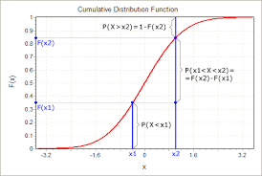
Probability Concept..
A cumulative distribution function is defined as a function that gives the probability of a random variable being less than or, equal to a given value. It can increased to a maximum of 1.

Slide 5
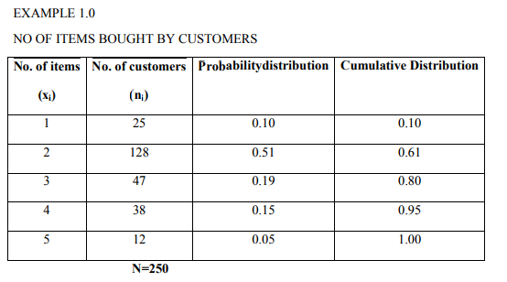

Slide 6
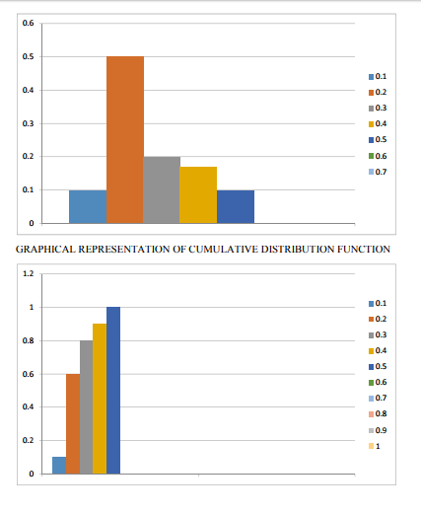
GRAPHICAL REPRESENTATION OF PROBABILITY MASS FUNCTION

Slide 7
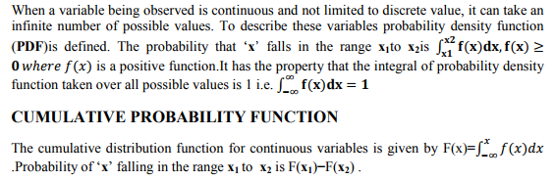
CONTINUOUS PROBABILITY FUNCTION

Slide 8
Random number and its Properties
A number generated for, or part of, a set exhibiting statistical randomness.
A random sequence is obtained from a stochastic process.
Random numbers are numbers that occur in a sequence such that two conditions are met:
(1) the values are uniformly distributed over a defined interval [0-1]-uniformity
(2) it is impossible to predict future values based on past or present ones-independence

Slide 9
Computer generation of random numbers
There are different methods
i) Congruence methods
Linear congruence generation (LCG)
Additive congruence generation
Multiplicative congruence generation
Mixed congruence generation
ii) Mid-square method
iii) Inverse transformation method
iv) Rejection method

Slide 10
Linear congruence generation
It produces the sequence of integer x1, x2 - - - - - between 0 and m-1 by following recursive relationship
xi+1= (axi+c) mod m ,i=0,1,2,.......... m-1
The initial value x₀ is called the seed.
a is called as multiplier,
c is called increment
m is modulus.
If c≠0 then the form is called mixed congruential generator.
If c=0 , then the form is called multiplicative congruential generator.
If a=1 , then the form is called additive congruential generator.

Slide 11
Linear congruence generation….
Examples:
Q1: Generate 4 digit random number by LCG with x₀=21, a=34, c=7.
Ans: Given generating 4-digit random number
i.e. m=10000 and
X₀=21, a=34, c=7.
X₁= (ax₀+c) mod m=(34*21+7) mod 10000= 721 R₁= X₁/m =721/10000=0.0721
X₂= (ax₁+c) mod m=(34*721+7) mod 10000=4521 R₂= X₂/m =4521/10000=0.4521
X₃= (ax₂+c) mod m=(34*4521+7) mod 10000= 3721 R₃= X₃/m= 3721/10000=0.3721
X₄= (ax₃+c) mod m=(34*3721+7) mod 10000=9311 R₄= X₄/m =9311/10000=0.9311
X₅= (ax₄+c) mod m=(34*9311+7) mod 10000=6581 R₅= X₅/m =6581/10000=0.6581

Slide 12
Q2: Generate 5 random numbers using additive congruential method with X₀=5, c=7, m=64.
Ans:
Here a=1, x₀=5, c=7, m=64
X₁= (ax₀+c) mod m= (1*5+7) mod 64= 12
R₁= X₁/m=12/64=0.1875
X₂= (ax₁+c) mod m=(1*12+7) mod 64=19
R₂= X₂/m= 19/64=0.2968
X₃= (ax₂+c) mod m= (1*19+7) mod 64= 26

Slide 13
R₃= X₃/m= 26/64= 0.4063
X₄= (ax₃+c) mod m= (1*26 +7) mod 64=33
R₄= X₄/m= 33/64= 0.5156
X₅= (ax₄+c) mod m= (1*33+7) mod 64= 40
R₅= X₅/m= 40/64= 0.625

Slide 14
Q3: Generate 5 random number using multiplicative congruential method with X₀=63, a=19, m=100.
Ans:
Given generating random numbers using multiplicative method i.e. c=0 and given X₀=63,a=19 , m=100
So X₁= (ax₀+c) mod m= (19*63+0) mod 100=97
R₁= X1/m=97/100=0.97
X₂= (ax₁+c) mod m=(19*63+0) mod 100=43
R₂= X₂/m= 43/100=0.43
X₃= (ax₂+c) mod m=(19*43+0) mod 100=17
R₃= X₃/m=17/100=0.17
X₄= (ax₃+c) mod m=(19*17+0) mod 100=23
R₄= X₄/m= 23/100=0.23
X₅= (ax₀+c) mod m==(19*23+0) mod 100=37
R₅= X₅/m=37/100=0.37

Slide 15
Q4: Use the mixed congruential method to generate a sequence of three 2-digit random number with X₀=37, a=7, c=29
Ans:
Given generating 2-digit random number so m=100 and given x₀=37, a=7, c=29
So X₁= (ax₀+c) mod m= (7*37+29) mod 100=88
R₁= X1/m=88/100=0.88
X₂= (ax₁+c) mod m=(7*88+29) mod 100=45
R₂= X₂/m= 45/100=0.45
X₃= (ax₂+c) mod m=(7*45+29) mod 100=44
R₃= X₃/m=44/100=0.44

Slide 16
MID-SQUARE METHOD
This method was proposed by Von Neumann and metropolis.
The technique starts with an initial no. or seed.
This number is squared and the middle digit of the square becomes the random number after placement of the decimal.
Again the middle digits are squared to generate the second random number and so on.

Slide 17
Example:
X₀= 5497
(X₀)²= (5497)²
=30217009
X₁=2170
R₁= X₁/m= 2170/10⁴= 0.2170
(X₁)²= (2170)² = 04708900
X₂= 7089
R₂= X₂/m= 0.7089

Slide 18
Drawbacks:
Zeros are repeated in further numbers generated.
It starts degenerating for multiples of 10, 100, ……

Slide 19
TESTS FOR RANDOM NUMBERS
Properties of random number
Uniformity
Independence
UNIFORMITY:
Frequency Test:
It uses Kolmogorov-Smirnov or the Chi-square test to compare the distribution of the set of numbers generated to a uniform distribution.
INDEPENDENCE:
Auto-co-relation test:

Slide 20
It tests the co-relation between numbers and compares the sample co-relation to the expected co-relation that should be 0.
There are some more tests for independence-
Run test
Gap test
The testing for uniformity of the hypothesis are:
H₀: Ri~U[0,1] called null hypothesis.
The null hypothesis H0 reads that the random number distributed in between [0,1]
H₁:Ri notU[0,1]
Failure to reject the null hypothesis means that evidence of non-uniformity has not been detected by this test.
In test for independence the hypothesis are-
H0:Ri~independent
H₁:Ri independent rejected

Slide 21
KOLMOGOROV SMIRNOV
This test compares the continuous cdf F(x) of the uniform distribution with the empirical cdf S_{N}(x) of the sample of N observation.
By definition,
F(x)=x, 0<=x<=1
If the sample from the random number generator is-
R₁,R₂,R₃……R _{N}
S_{N}(n)=no. of R_{1,}R_{2,……} R_{N} which are <=x
This test is based on the statistical D=max | f(x)=S_{N}(x) |

Slide 22
KOLMOGOROV SMIRNOV
Step-1
Rank the data from smallest to largest. Let R_{i} denotes the smallest i^{th} observation-
R₍₁₎<=R₍₂₎<=……<=R _{(N)}
Step-2
Compute –
D⁺=max_{1<=i<N} {i/N=R_{(i)}}
D⁻=max_{1<=i<N} {R_{i}-(i-1)/N}

Slide 23
KOLMOGOROV SMIRNOV
Step-3
Compute D=max(D⁺,D⁻}
Step-4
Locate in table the critical value Dα for the specified significant table ‘ α’ & the given sample size ‘N’.
Step-5
If the sample statistic (D) > the critical value (D_{α}) the null hypothesis that the data are sample from a uniform distribution is rejected.
If D<= D_{α} conclude that no difference has been detected between the true distribution & the uniform distribution.

Slide 24
KOLMOGOROV SMIRNOV
For each test a table of significance ‘ α’ is tested. This table is the probability of rejecting the null hypothesis , when the null hypothesis is true.
The decision marker sets the value of ‘ α’ for any tests frequently α=0.01 or 0.05.

Slide 25
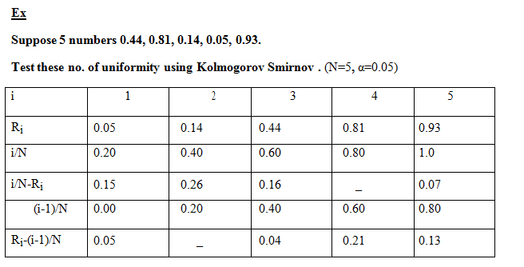

Slide 26
Step-1
D⁺=0.26
Step-2
D⁻=0.21
Step-3
D=max(0.26,0.21)=0.26
Step-4
α=0.05 , N=5
D α=0.565
Step-5
As D<D α, the sequence of random no. is uniformly distributed & the null hypothesis is not rejected.

Slide 27
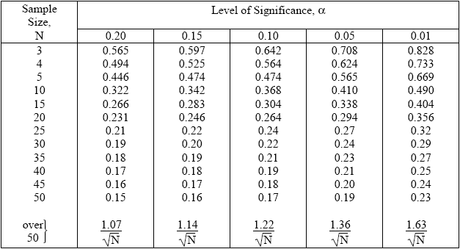
Kolmogorov Smirnov Table

Slide 28


Chi-Square Test
The test uses the sample statistics
Where, Oi = The observed number in the ith class
Ei = Expected number in the ith class
n = Number of classes
For uniform distribution Ei is given by, x
Where, N = Number of Observation
n = classes
It is generally done when N≥0.

Slide 29
Chi-Square Test
Q: Test the following number for uniformity by Chi-square test. 0.15, 0.22, 0.11, 0.25, 0.09, 0.01, 0.28, 0.07, 0.13, 0.03
A: Here, N = 10 n = 10

Slide 30
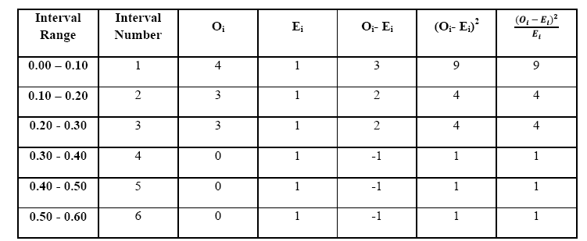
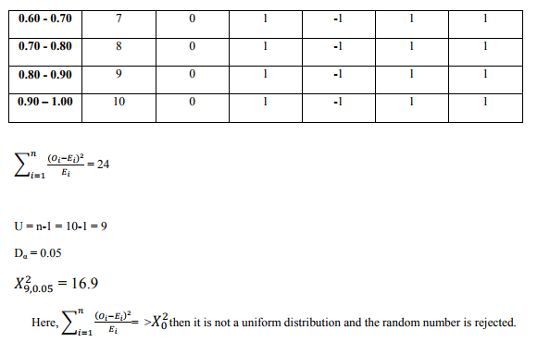

Slide 31
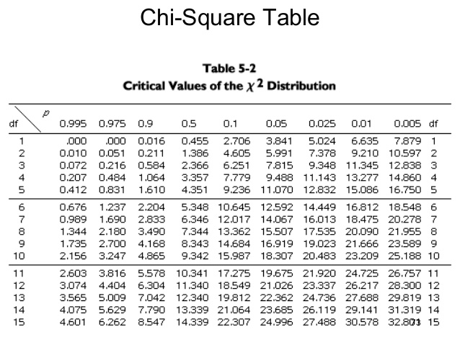

Slide 32
Run Test (Test for independence)
This test examines the arrangement of numbers in a sequence to test the hypothesis of independence.
Run:
Run is defined as a succession of similar events proceeded & followed by a different event.
HT TH HT TTHT
1 2 3 4 5 6
Total run=6
Length of run:
Length of the run is the no. of the event occur in the event.
HTTHHTTTHT
1 2 2 3 1 1

Slide 33
Run Test cont..
UP RUN:
An up run is a sequence of number each of which is succeeded by a larger number- 0.07 0.12 0.53 0.85 0.92
Down Run:
A down run is a sequence of numbers each of which is succeeded by a smaller no.

Slide 34
Run Test
0.92 0.87 0.75 0.53 0.21 0.13
- - - - -
If ‘N’ is the no. of numbers in a sequence the maximum no. of runs is N-1 & minimum no. of runs is 1.
If ‘a’ is the total no. of runs in a truly random sequence the mean & variance of ‘a’ is given by-
Mean
µ _{a}=(2N-1)/3
Variance
σ_{a}²=(16N-29)/90
=>j16l 29/90

Slide 35
Run Test cont…
Test Statistic
Z₀=(total no. of runs-mean)/standard deviation
=>(a-µ _{a})/σ_{a}
where Z₀ is normally distributed variable with mean 0 & variance 1.
Failure to reject hypothesis of independence occurs when -Z_{α}<=Z₀<=Z_{α/2} where α is the label of significance.

Slide 36
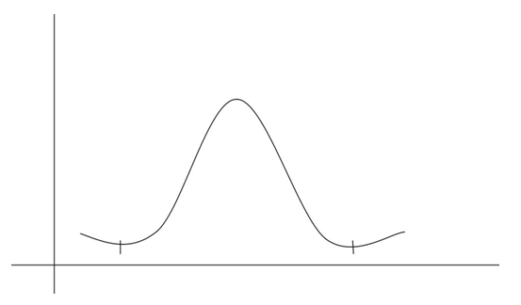

Slide 37
Run Test cont..
Steps
Find the sequence of runs up & runs down.
Find total no. of runs denoted by ‘a’.
Find mean & standard deviation.
Compute the test statistic Z_{0.}
Compare it with the theoretical value.
If - Z_{α/2}<Z₀<= Z_{α/2}, then null hypothesis of independence cannot be rejected on the basis of test and the sequence of random no. is independent. Hence it passes the runs test.

Slide 38
Ex Perform runs test on the following sequence of random numbers : 0.08,0.09,0.43,0.29,0.42,0.53,0.68,0.10,0.76,0.98 0.08 0.090.430.29 0.42 0.53 0.680.100.76 0.98 1 2 3 4 5
No. of runs a=5,
N=10
Mean,
µa=(2N-1)/3=((2*10)-1)/3=19/3=6.33
Variance=σa 2 =(16N-29)/90=((16*10-29)/90=1.455 Standard deviation σa=√1.455 Test statistic Z0=(no. of runs-mean)/standard deviation =(5-6.33)/√1.455 =-1.099

Slide 39
Critical value Suppose α=0.05 α/2=0.025
-Zα/2=-1.96, Zα/2=1.96
So,
-1.96<=Z₀<=1.96, so we cannot reject the null hypothesis of independence on the basis of this test & this sequence of numbers passes the runs test.

Slide 40

Tests for Auto-correlation
The tests for auto-correlation are concerned with the dependence between numbers in a sequence.
The list of the 30 numbers on page 311 appears to have the effect that every 5th number has a very large value. If this is a regular pattern, we can't really say the sequence is random.
The test computes the auto-correlation between every m numbers (m is also known as the lag) starting with the ith number.
Thus the autocorrelation between the following numbers would be of interest.

Slide 41

The value M is the largest integer such that where N is the total number of values in the sequence.
E.g. N = 17, i = 3, m = 4, then the above sequence would be 3, 7, 11, 15 (M = 2). The reason we require M+1 instead of M is that we need to have at least two numbers to test (M = 0) the autocorrelation.
Since a non-zero autocorrelation implies a lack of independence, the following test is appropriate
For large values of M, the distribution of the estimator , denoted as , is approximately normal if the values are uncorrelated.
Form the test statistic

Slide 42
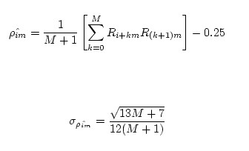
which is distributed normally with a mean of zero and a variance of one.
The actual formula for and the standard deviation is

Slide 43

After computing , do not reject the null hypothesis of independence if
where is the level of significance.
Refer class assignment for example.

Slide 44
